Slide 1

Incentivizing Peer-Assisted Services a Fluid Shapley Value Approach
        V. Misra, Columbia University
        S. Ioannidis, L. Massoulié, Technicolor
        A. Chaintreau
        Wednesday, June 16th, talk @ Sigmetrics
Notes:
Technicolor+credit to Josh/Stratis

Slide 2
Structure of this talk
Motivation
Requirements for incentivizing peer-assistance
A Fluid-Atomic Shapley approach
Applications
Concluding remarks

Slide 3
Peer-to-Peer (P2P) is a double edged sword
P2P is technically beneficial …
    Self-Scaling, Resilient, Versatile
… but it puts Internet economy under stress
    Content right owners see a shrinking revenue
    Access network providers see increasing traffic
Internet becomes engineering/regulatory battlefields
    Traffic filtering … will it work?
    Network neutrality … will it block innovation?

Slide 4
An alternative to P2P
We focus here on peer-assisted services
    A service offered by a provider, for a given price
    Some users commit their resources to assist in provision of service
Address P2P via an economic rethink
    Allows to fight illegal content with equal arms
    (through added features, authentication etc.)
    Focus on fairness and efficiency

Slide 5


Examples of peer-assisted services
Content
Server
?
The Internet
Peer-assistance
enabled
?
?
Residential Gateways
(owned and managed by the ISP)

Slide 6

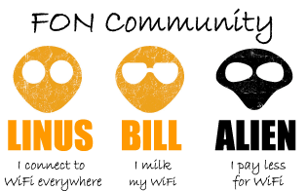

Examples of peer-assisted services (cont'd)
A principle found in multiple scenarios
    Content: broadband, mobile
    peer-assistance: retrieve content locally
    Bandwidth: wireless community, femtocell
    peer-assistance: make access available
    CPU: Crowdsourcing
    peer-assistance: provide computing power

Slide 7
Incentivizing peer assistance
Incentives have been studied in P2P for several years
    Focus on churn, free-riding, sybil attacks
    Indeed, much of P2P today relies on altruistic users
Incentive is critical for peer-assisted services
    Deployment: users should decide to opt-in
    Stability: users keep control on their own resources
    (e.g. unplug or throttle their gateway)
    Provider wants to have guaranteed revenue.

Slide 8
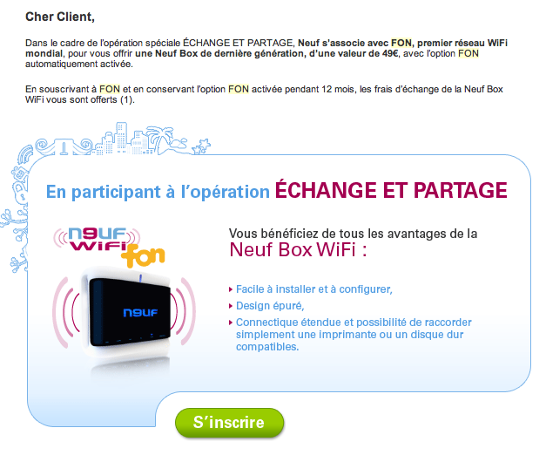
Solutions deployed today
One-shot incentive to Opt-in
    receive a gift
    (free upgrade or feature)
    or even make you pay!
Sharing common resource
    Restricted to a zero value economy
Revenue sharing
    Looks more general and promising but how to tune it?

Slide 9
Structure of this talk
Motivation
Requirements for incentivizing peer-assistance
A Fluid-Atomic Shapley approach
Applications
Concluding remarks

Slide 10
An incentive mechanism for peer-assistance
Stability/Fairness
  loose: individually rational users do not leave
  tight: derived from objective fairness axioms
Economically efficient
  loose: sum of incentives matches cost reduction
  tight: optimality = system leads to minimum cost
Manage different scales
  Interaction of large user population and big players
Computationally efficient

Slide 11




Cooperative Game, "Should I stay or should I go?"
Players:
Coalition:
Value:
Value:
Coalitions
Coalition:
Value:

Slide 12
Shapley Value
Efficiency
Symmetry

Slide 13
Shapley Value
Efficiency
Symmetry
Balanced contribution
Shapley value is equal to
Exponential Complexity!

Slide 14
Structure of this talk
Motivation
Requirements for incentivizing peer-assistance
A Fluid-Atomic Shapley approach
Applications
Concluding remarks

Slide 15
Incentivizing peer-assistance
A new multi-class fluid-atomic approach
    1 atomic player: the provider (revenue per user)
    Peers represented by continuous fluid in m classes.
    Let denote the fraction of participating peers in each class
    Let be the marginal service cost per user
(Traditional service)
(Provider is a veto player)
(Peer-assisted service)

Slide 16
Shapley Value Fluid limit
Efficiency
Symmetry
Balanced contribution
Shapley value is equal to
Efficiency
Symmetry
  Users in class i have
Balanced contribution

Slide 17
More remarks
The formal proof uses limit axioms
    Simplifies results from Aumann-Shapley74 and Hart73
    Using a limit of balanced contribution Myerson77
The limit axioms offers a flexible methodolody
    multiple atomic players
    other scenarios like network neutrality
    cost of peer-assistance incurred by user

Slide 18
Structure of this talk
Motivation
Requirements for incentivizing peer-assistance
A Fluid-Atomic Shapley approach
Applications
Concluding remarks

Slide 19
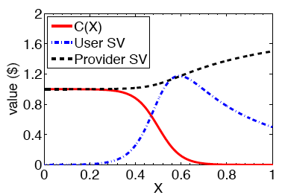
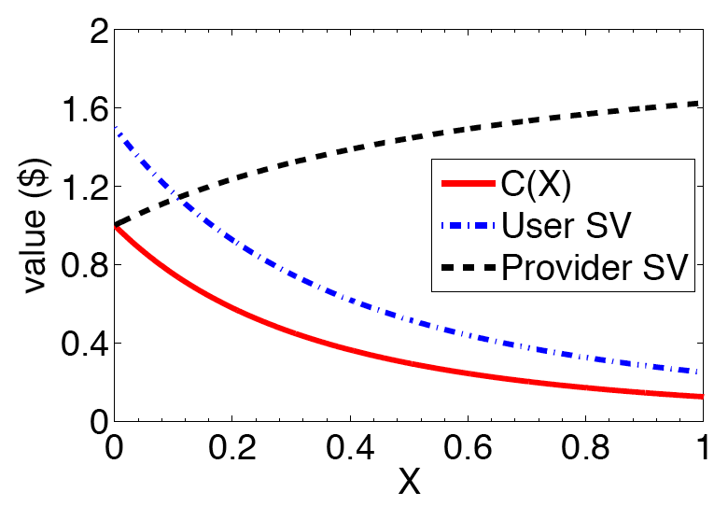
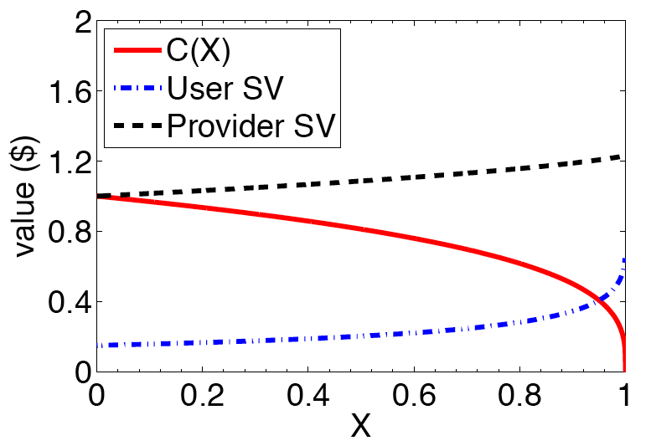
Qualitative properties
General conditions to achieve grand coalition
    Cost saving should compensate cost of sharing
Provider's Shapley value always increases with X
Peer's Shapley Value
    Combination of 2 effects
      Cost reduction
      Loss of bargaining power
    Characterized by
    concavity/convexity

Slide 20
Quantitative properties
Linear cost:
    Shapley value independent of X
Example: VoD with peer-assistance
    File size ; class i upload bits; cost bwidth
    Cost per user becomes
    Shapley value:
    "Serve two, get one free" is fair and optimal

Slide 21
Conclusion
Economic rethink of peer-assistance
    Provides strong fairness/efficiency guarantee
    Flexible: interaction of peers and big players, …
    Computationally simple: closed form expressions
Future works
    Can we apply this model to energy-efficient operation of (distributed) services?
    Can we handle competing providers?

Slide 22
Thank you!
Notes:
Mobility of anticipated users movement and actual traces.

Slide 23


Cooperative Game theory
Set of players a subset is called a coalition
    Value of Coalition is the sum of players' profits
    Player i receives a share
How to share revenue in a coalition?
    Stability: users, individually rational, do not leave
    Grand coalition: all users become active
    To ensure "fairness"

Slide 24

The Shapley Value
Defined using objective conditions
    Symmetry axiom
    Efficiency axiom (loose version)
    Balanced contribution axiom
Leads to stability and grand coalition
    Under general conditions
    (super-additivity, super-modularity)
Unfortunately, incurs an exponential complexity!

Slide 25


Incentivizing peer-assistance
We assume that, as the number of peers gets large
THM: The Shapley values of peers and the shapley value of the provider per peer follow
a closed form

Slide 26

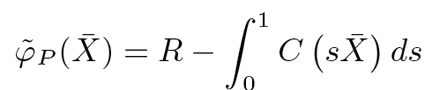

An intuitive proof
Shapley value equals E[V(S(pi,i) U {i} ) – V(S(pi,i)]
    where S(pi,i) containing predecessors of i in a random "permutation" chosen uniformly
    Let s in [0;1] be the relative "rank" of a player i in the permutation pi. (essentially it is uniform on [0;1])
As the system becomes large
    By law of large numbers, S(pi,i) contains
    If i is not P, then S(pi,i) contains P with probability s

