Slide 1
Toward Applying Quantum Computing to Network Verification
Kahlil Dozier, Kylie Berg, Justin Beltran, Hugo Matusek, Loqman Salamatian, Ethan Katz-Bassett, Dan Rubenstein
Columbia University

Slide 2
The Practicality of Quantum Computing
To be practical, quantum computers need many stable qubits
Currently, rapid hardware progress both in number and stability
Potential applications exist, but are currently somewhat limited in scope (factoring, QKD, materials sci, ML)
# qubits
Progress
Q: are there applications in networking where quantum computing may be useful?
qubit stability
Applications

Slide 3
A: Maybe? Network Verification (NWV) seems a good fit
Why? Because…
  NWV often decomposable into massive # of short, independent parallel jobs
  Just need a good way to run those jobs in parallel (hint: quantum)
Disclaimers:
  Our Quantum Approach here (preliminary): “unstructured” search
    Only achieves quadratic speedup over classical (we’ll see that’s still pretty good)
    With right “structure”, quantum could give exponential speedup (much faster, but very hard to find usable “structure”)
  Existing hardware can only support toy networks
    No quantum advantage yet: existing HW can’t support enough jobs to “parallelize”

Slide 4
Structure of Talk
What is network verification (NWV)?
Solving NWV via…
  (Deterministic) Turing Machine Verifier (unstructured)
  Classical Computation using “structure” [Kaezmain’12, Steffen’20]
  Non-Deterministic Turing Machine Verifier (unstructured)
  Quantum Computing via Grover’s Algorithm (unstructured)
Is Quantum worth it?

Slide 5

Network Verification (NWV)
S
Core idea: check if some property always (never) holds for a given network
  E.g. (never): when routing S D, avoid B
    Data Plane Example: header forwarding rules [Kazemain’12]
    Control Plane Example: BGP with link failures [Steffen’20]
B
D

Slide 6
Network Verification (NWV)
Pkt header
S
011101101010101101
111101101010101101
*
0101??1* → 0101??0*
0??1011* → 1??0011*
01*
1001*
1??1011* → 1??0011*
Core idea: check if some property always (never) holds for a given network
  E.g. (never): when routing S D, avoid B
    Data Plane Example: header forwarding rules [Kazemain’12]
    Control Plane Example: BGP with link failures [Steffen’20]
Each individual source header can be quickly analyzed
Q: Why is verification is challenging?
a) Changes to headers en-route complicate analysis
b) n-bit headers → 2^{n} source headers to consider
B
[HSA’12] Kazemian, Varghese, McKeown, Header space analysis: Static checking for networks. NSDI 12
D

Slide 7
Network Verification (NWV)
S
X
Core idea: check if some property always (never) holds for a given network
  E.g. (never): when routing S D, avoid B
    Data Plane Example: header forwarding rules [Kazemain’12]
    Control Plane Example: BGP with link failures [Steffen’20]
      If each link fails w/ probability p, do we avoid B at least 99.999% of time
X
B
A given set of link failures can be quickly analyzed
Q: Why is verification is challenging?
a) Routing Protocol can react to link failures in complex ways
b) n links → there are O(2^{n}) failure scenarios to consider
D
[Steffen20] Steffen, Gehr, Tsankov, Vanbever, Probabilistic verification of network configurations. SIGCOMM’20

Slide 8
Structure of Talk
What is network verification (NWV)?
Solving NWV via…
  (Deterministic) Turing Machine Verifier (unstructured)
  Classical Computation using “structure” [Kaezmain’12, Steffen’20]
  Non-Deterministic Turing Machine Verifier (unstructured)
  Quantum Computing via Grover’s Algorithm (unstructured)
Is Quantum worth it?

Slide 9
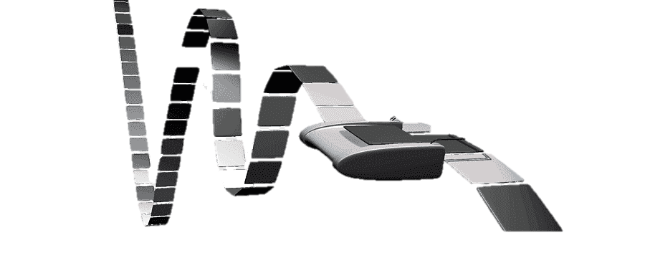
“Unstructured” approach to NW Verification
Recall a (Verifying) Turing Machine:
  Takes a single input that is the program
  Returns “success” or “fail” bit: Input did not violate / did violate the property
{
0: No
1: Yes
Program
(incl. input)
“Verifying” Turing Machine
Program that includes an input produces one (1-bit) output

Slide 10


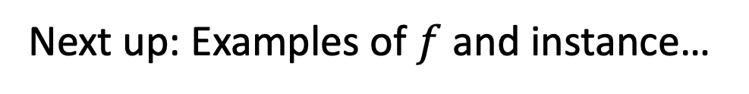
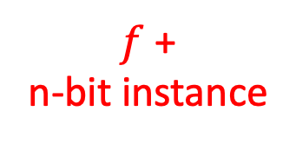
“Unstructured” approach to NW Verification
Turing Machine program consists of:
  “Static” verifier function $f$
  “Varying” n-bit Instance for the problem
$f$: a Verifier program w/ 3 parts:
  Network instance generator
  Protocol Implementor
  Property Checker
Program + Input
$f$ +
n-bit instance
(instance)
Output
0 (no violation)
1 (violation)
Turing Machine
Next up: Examples of $f$ and instance…

Slide 11
Unstructured Verification examples
Data Plane
Control Plane
(instance)

Slide 12
Unstructured Data Plane
S
111101101010101101
011101101010101101
100110001010101010
*
0101??1* → 0101??0*
0??1011* → 1??0011*
01*
1001*
1??1011* → 1??0011*
Data Plane [HSA’12] (Avoids B?)
Control Plane
Routers and links
Routing Rules
1 – fail!
0 – success!
Gen pkt instance
Another pkt instance
(packet header
Instance)
1st try was a success (avoided B).
Keep trying other headers (different input)
until failure found (or until exhaust all 2^{n} possibilities!)
B
D

Slide 13
Unstructured Ctrl Plane
S
X
X
Data Plane [HSA’12] (Avoids B?)
Control Plane [Steffen’20] (Avoids B?)
Routers and links
X
X
Link outage set
Another Link outage set
1 – fail!
0 – success!
(link outage instance)
X
1st try was a success (avoided B).
Keep trying other link outage instances (different input)
until failure found (or until ∑P(considered instances) > 99.99%)
O(2^{k}) instances to consider (for fairly large k)
B
D

Slide 14
Pros / Cons of Unstructured Verification
Pro: Can quickly verify for each input (instance), e.g.,
  Data Plane: does a specific packet header violate property?
  Ctrl Plane: does a specific combination of link outages violate property?
Con: Potentially exponentially many instances to check, e.g.,
  Data Plane: n-bit header: 2^{n} instances
  Ctrl Plane: Subset of n links failing: O(2^{n}) failure configurations
  Q: How to make scale?
  A: Prior art: use “structured” approaches on classical (non-quantum) computers

Slide 15
Structure of Talk
What is network verification (NWV)?
Solving NWV via…
  (Deterministic) Turing Machine Verifier (unstructured)
  Classical Computation using “structure” [Kaezmain’12, Steffen’20]
  Non-Deterministic Turing Machine Verifier (unstructured)
  Quantum Computing via Grover’s Algorithm (unstructured)
Is Quantum worth it?

Slide 16
Structured Approach
Space of all headers
S
*
0101??1* → 0101??0*
0??1011* → 1??0011*
01*
1001*
1??1011* → 1??0011*
Data Plane Example: header forwarding rules [Kazemain’12]
    Consider “blocks” of headers that break down and recombine as routed
    Approach works well as long as routing rules “not too fancy”
      Routers in middle of the network are “passive”
      Avoid additive properties (e.g., delay)
Structured Approaches work well for some properties and some protocol configurations
Easily overwhelmed for some property/configuration combos
B
[HSA’12] Kazemian, Varghese, McKeown, Header space analysis: Static checking for networks. NSDI 12
D

Slide 17
Structure of Talk
What is network verification (NWV)?
Solving NWV via…
  (Deterministic) Turing Machine Verifier (unstructured)
  Classical Computation using “structure” [Kaezmain’12, Steffen’20]
  Non-Deterministic Turing Machine Verifier (unstructured)
  Quantum Computing via Grover’s Algorithm (unstructured)
Is Quantum worth it?

Slide 18
Speeding up Unstructured NW Verification
Nondeterministic Turing Machine
Program generates and evaluates (in parallel) all inputs
Input 0
Program
Input 1
…
Input k satisfies
(or fails to satisfy)
Input m
n input bits → m=2^{n} inputs: O(2^{n}) times faster than deterministic TM!

Slide 19
Structure of Talk
What is network verification (NWV)?
Solving NWV via…
  (Deterministic) Turing Machine Verifier (unstructured)
  Classical Computation using “structure” [Kaezmain’12, Steffen’20]
  Non-Deterministic Turing Machine Verifier (unstructured)
  Quantum Computing via Grover’s Algorithm (unstructured)
Is Quantum worth it?

Slide 20
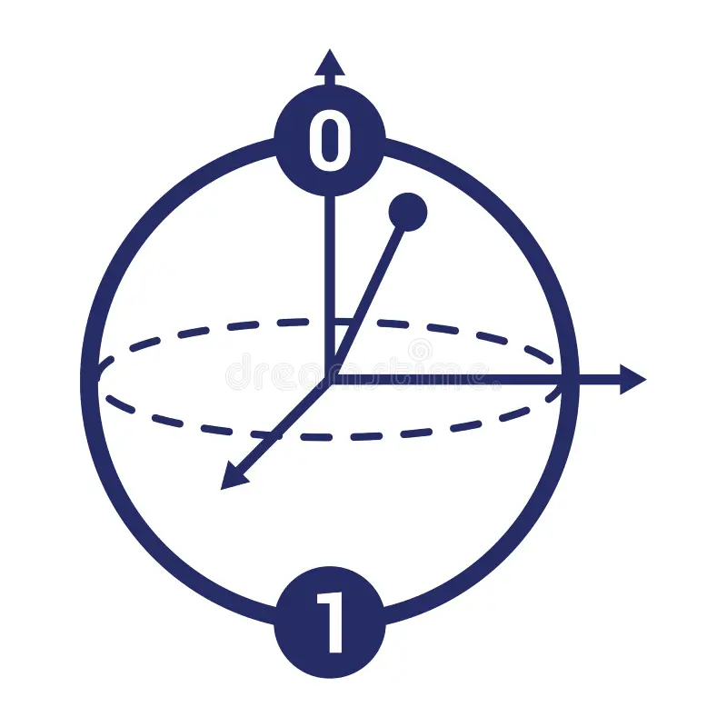
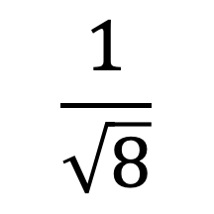
Quantum Computer
Like a non-deterministic Turing Machine (sort of)
}
e.g., n=3 (qu)bit input
|000〉+
|001〉+
|010〉+
|011〉+
|100〉+
|101〉+
|110〉+
|111〉
$$\frac{1}{\sqrt{8}}$$
All 2^{n} inputs simultaneously (in superposition)
Bloch-Sphere representation of a qubit
Equal superposition: when measured: P(0)=½ , P(1)=½

Slide 21
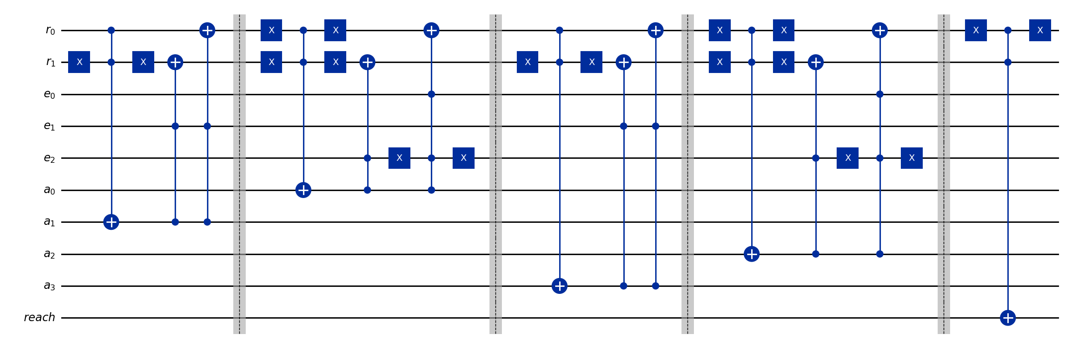
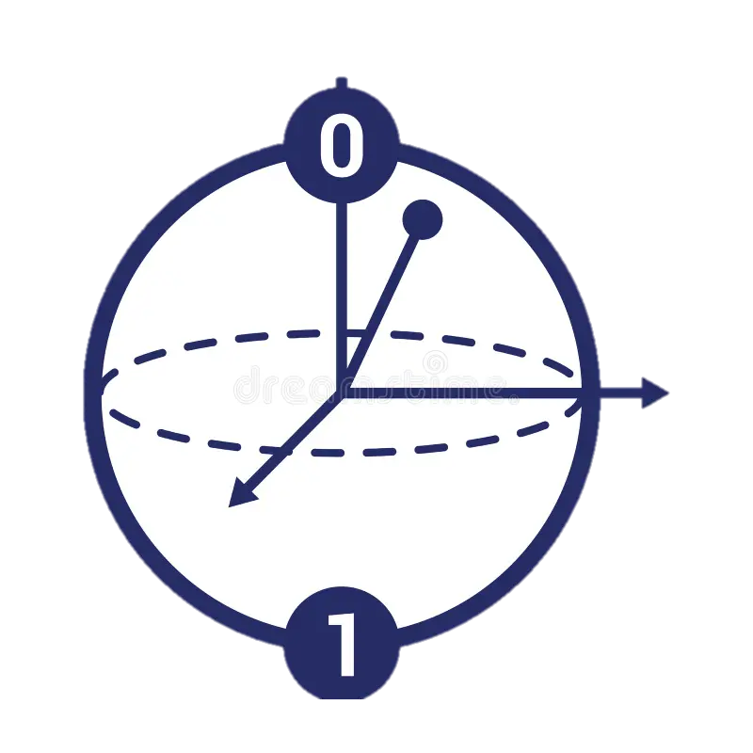
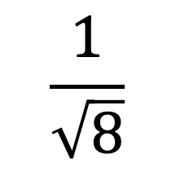

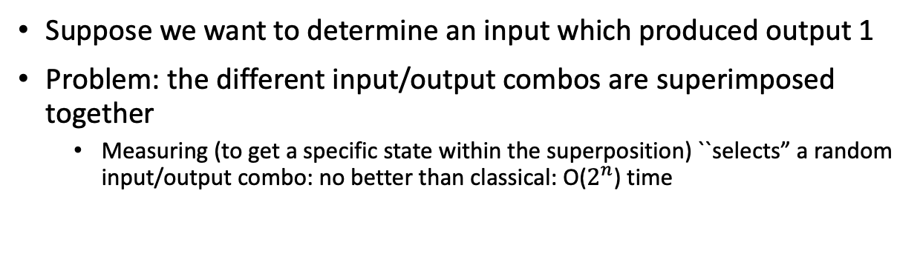
Quantum Computer
Exponential
(Non-Deterministic-TM-Like)
Speedup!!
Like a non-deterministic Turing Machine
|000101100〉
|000101100〉+
|001000111〉+
|010110100〉+
|011000000〉+
|100110110〉+
|101111110〉+
|110010101〉+
|111001000〉
Input qubits (in superposition)
|001000111〉
$$f$$
$$\frac{1}{\sqrt{8}}$$
|010110100〉
|011000000〉
|100110110〉
|101111110〉
Scratch qubits (all 0) - workspace
|110010101〉
|111001000〉
Circuit (Program)
Input
Output
Output qubit (= 0)
Suppose we want to determine an input which produced output 1
Problem: the different input/output combos are superimposed together
  Measuring (to get a specific state within the superposition) ``selects” a random input/output combo: no better than classical: O($2^{n}$) time

Slide 22

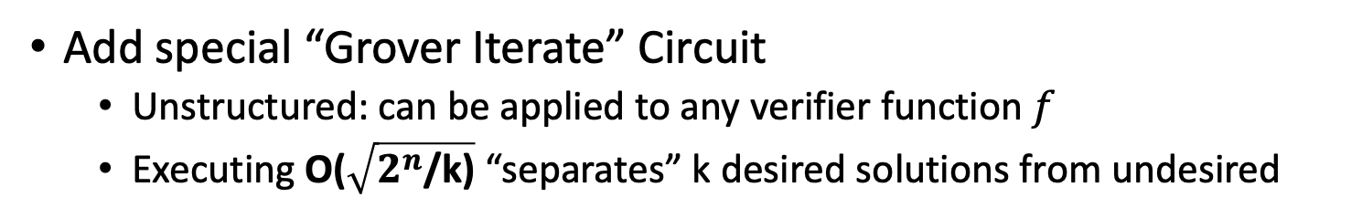

Grover’s Algorithm (quadratic speedup)
O($\sqrt{2^{n}\text{/}\text{k}}$) times through
Grover Iterate
Circuit
$$f$$
|111001000〉
|011000000〉
|101111110〉
|010110100〉
|100110110〉
|000101100〉
|001000111〉
|110010101〉
Add special “Grover Iterate” Circuit
  Unstructured: can be applied to any verifier function $f$
  Executing O($\sqrt{2^{n}\text{/}\text{k}\text{)}}$ “separates” k desired solutions from undesired

Slide 23
Structure of Talk
What is network verification (NWV)?
Solving NWV via…
  (Deterministic) Turing Machine Verifier (unstructured)
  Classical Computation using “structure” [Kaezmain’12, Steffen’20]
  Non-Deterministic Turing Machine Verifier (unstructured)
  Quantum Computing via Grover’s Algorithm (unstructured)
Is Quantum worth it? (Is quadratic speedup helpful?)

Slide 24
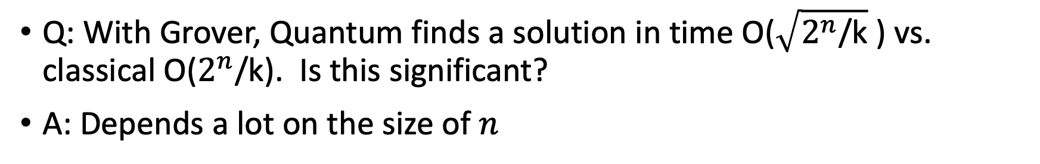
Is Quadratic Speedup useful?
Q: With Grover, Quantum finds a solution in time O($\sqrt{2^{n}\text{/}\text{k}}$ ) vs. classical O($2^{n}\text{/}$k). Is this significant?
A: Depends a lot on the size of $n^{}$
Assume to test an input:
  Classical machine needs 10 ms
  Quantum needs 1 sec (100x slowdown)
  Non-deterministic TM needs 1 hour
n (bits in input) | Classical time (unstructured) | Quantum time (a la Grover) | Nondeterministic TM
10 | ~ 5 seconds | ~32 seconds | 1 hour
32 | ~250 days | ~18 hours | 1 hour
48 | ~45,000 years | ~194 days | 1 hour
64 | ~3,000,000,000 years | ~136 years | 1 hour
If inputs are “reasonably sized” (~32-48 bits) then yes

Slide 25
Summary
We showed:
  Quantum applies to Network Verification by quadratically speeding up unstructured search
Some (very) preliminary results in our paper
  Analysis on # qubits needed (incl. scratch)
  Attempts at running QC on small (3-node) network
We admit:
  Quantum computing not ready for practical use for “reasonably sized” NWV problems
Important Future Direction: find some “structure” in the problem to either
  Reduce the search space and speedup via Grover
  Find a way to apply quantum with greater “power” (i.e., something beyond Grover)

Slide 26
Thanks!

Slide 27
Structured Approach
S
  Control Plane Example: BGP with link failures [Steffen’20]
      Identify “cold” links never (rarely) taken
      Exclude from set of links considered
      Hard to identify cold links in some scenarios (e.g., multiflow)
Structured Approaches work well for some properties and some protocol configurations
Easily overwhelmed for some property/configuration combos
B
D
[Steffen20] Steffen, Gehr, Tsankov, Vanbever, Probabilistic verification of network configurations. SIGCOMM’20

